Slide 1
Detecting Rigged Review and Rate(DRR)
Team 6
20160542 Hyunji Lee
20170344 Minjae Song
20180157 Junu Kim

Slide 2
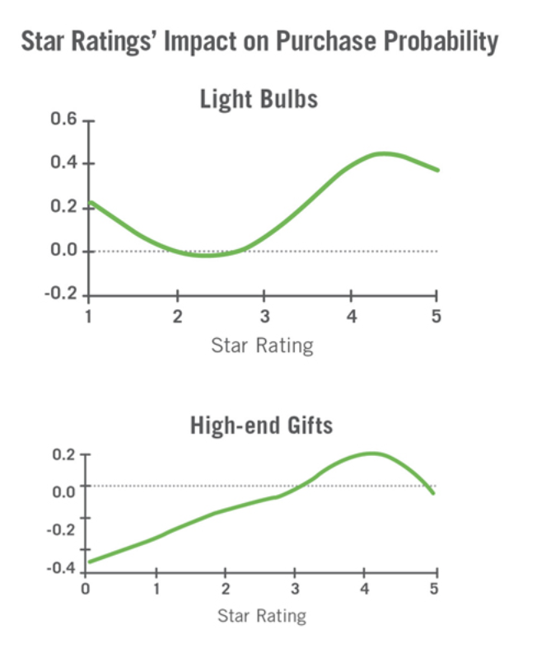
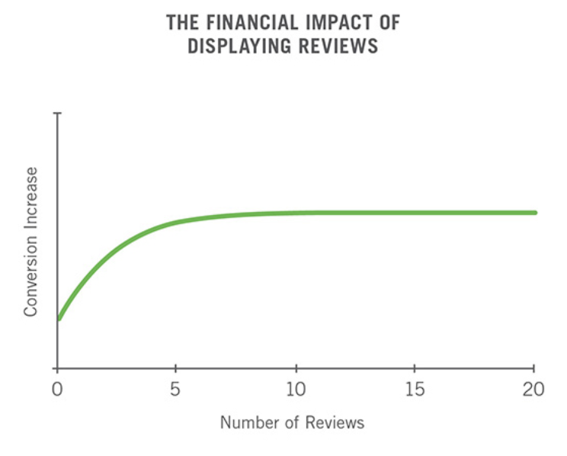
Importance of Reviews
https://spiegel.medill.northwestern.edu/online-reviews/

Slide 3
Abusing Reviews
Surge Hacking
Infringement of right to know

Slide 4
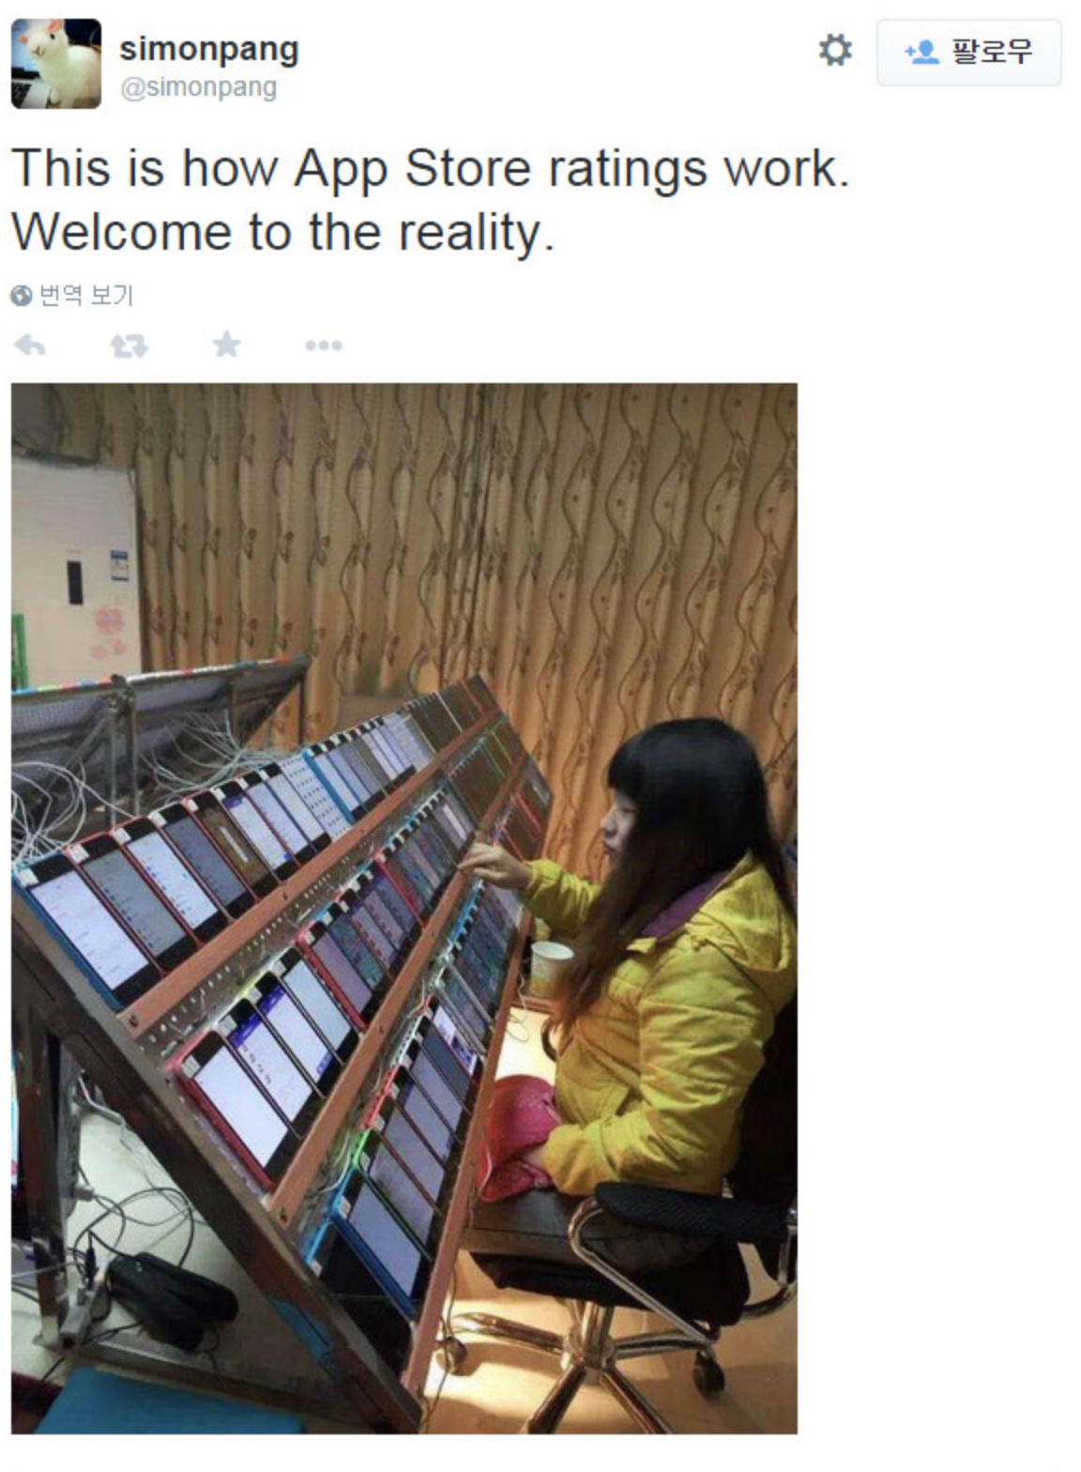
China Review Manufacturing
https://www.thisisgame.com/webzine/news/nboard/4/?n=57779

Slide 5
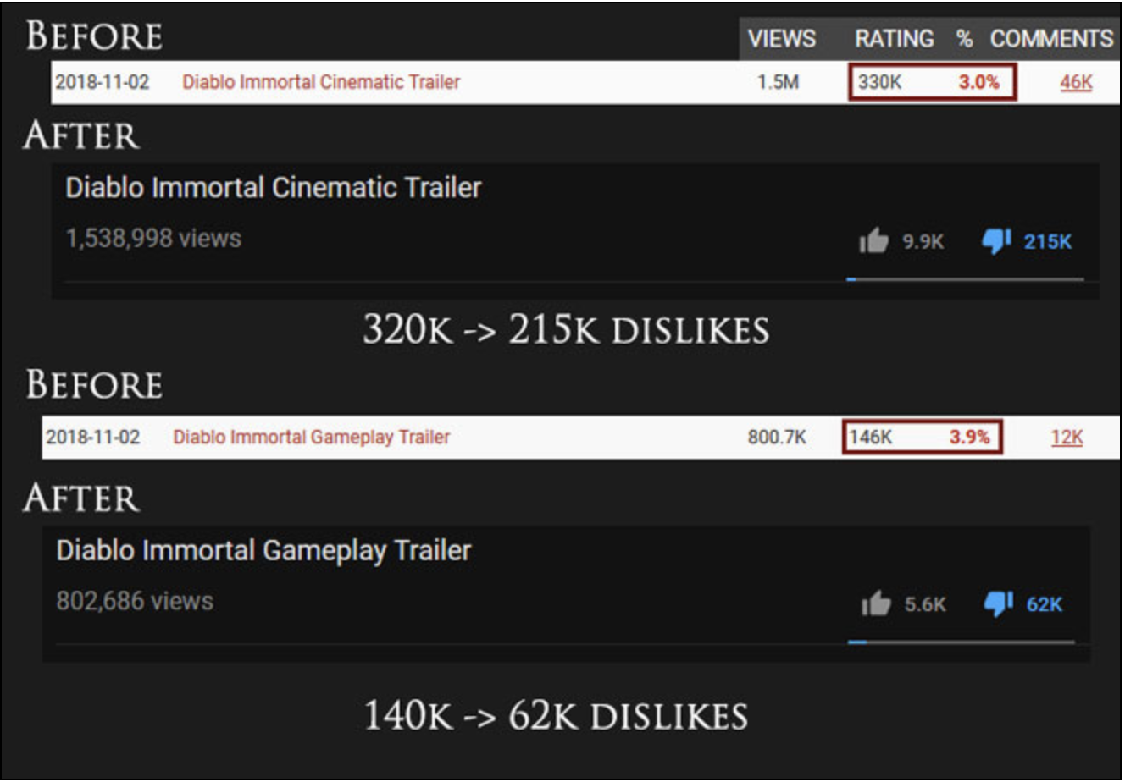
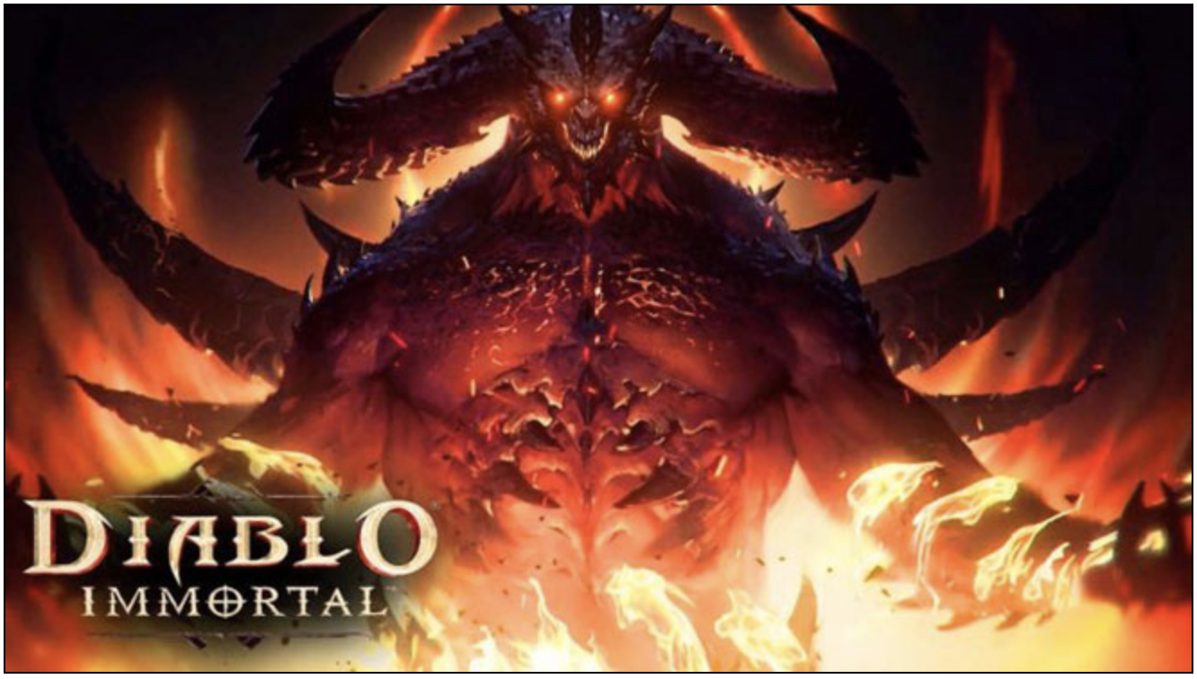
Blizzard Deleted Negative Reviews
https://kbench.com/?q=node/192794

Slide 6
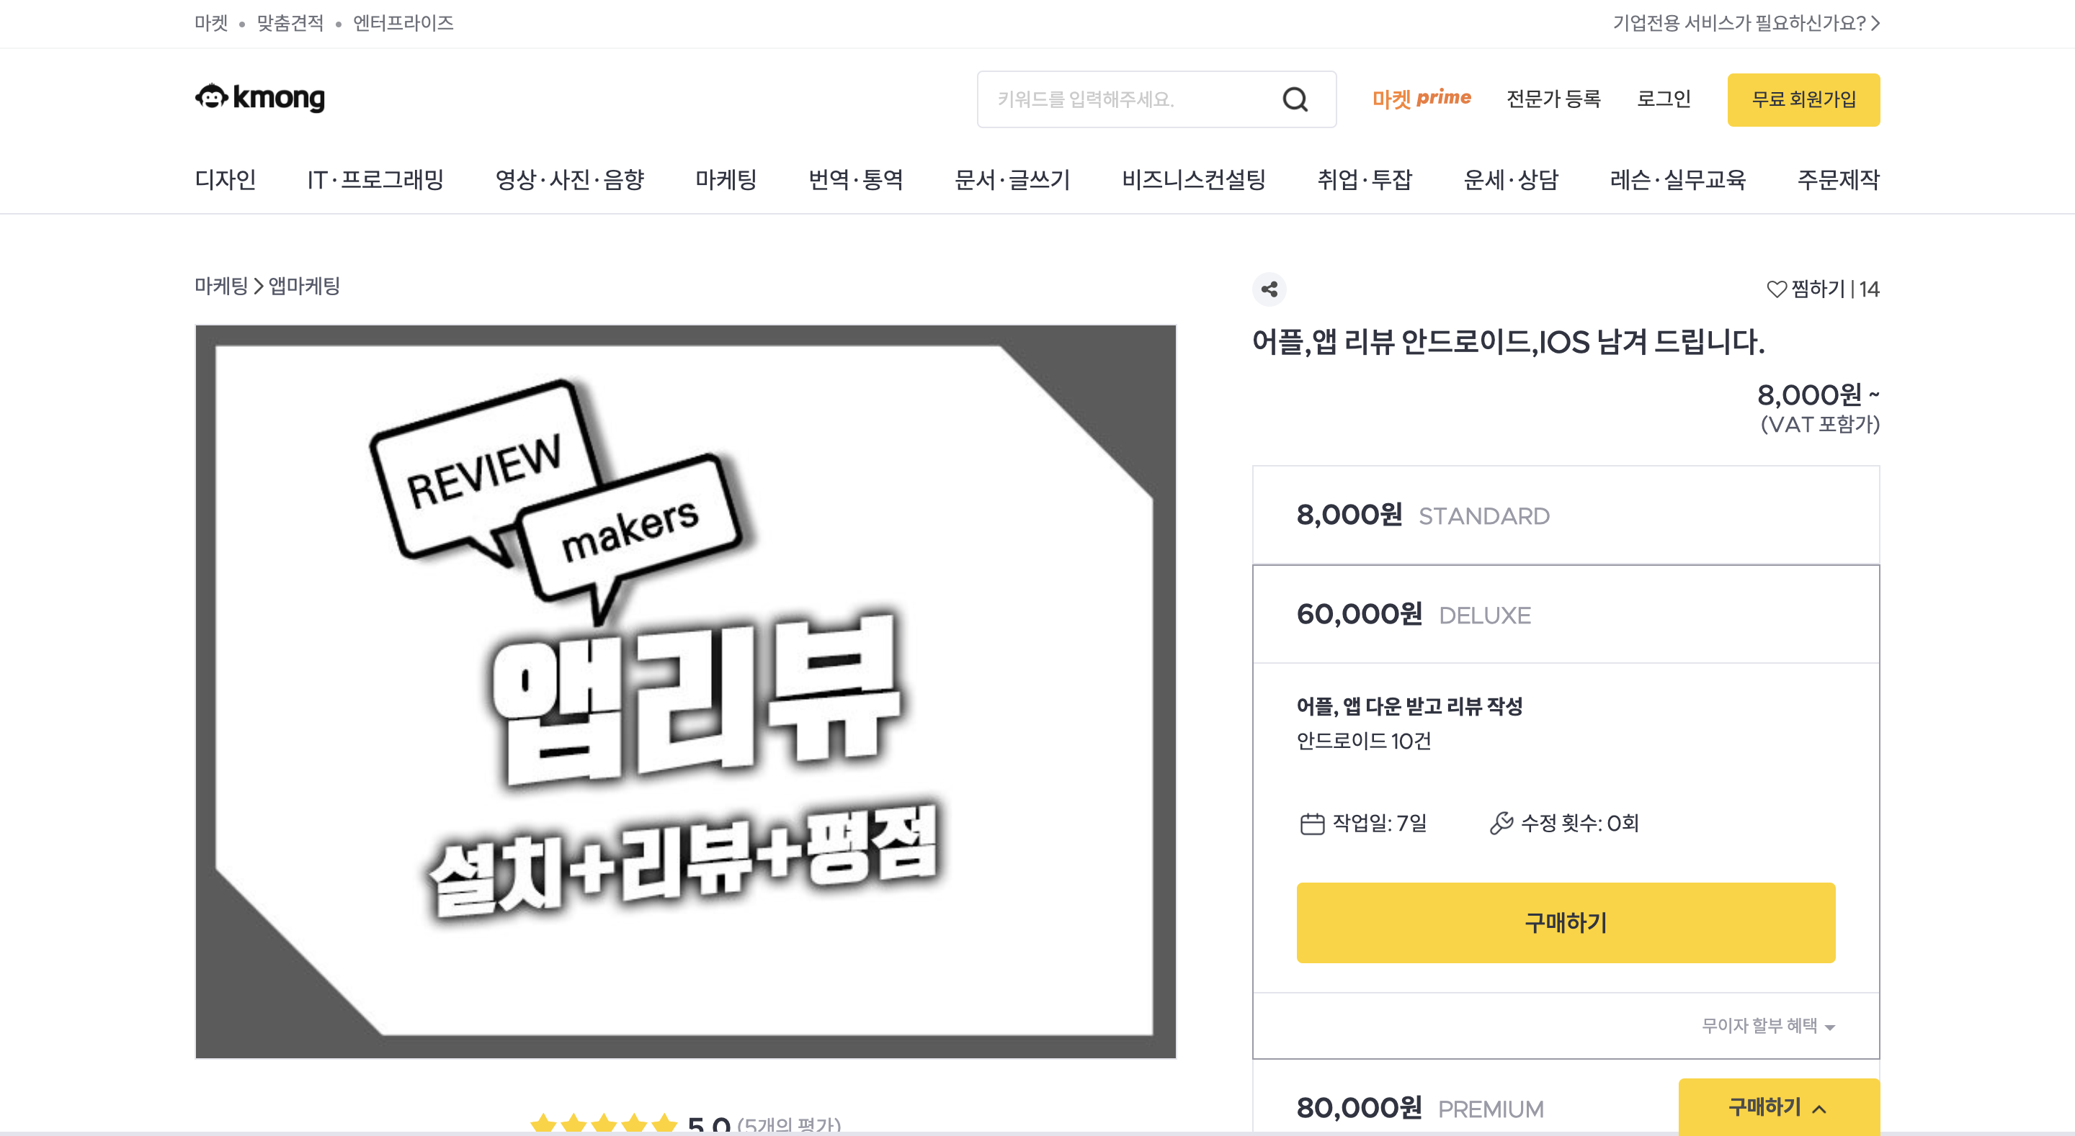
Review Marketing
https://kmong.com/category/202

Slide 7
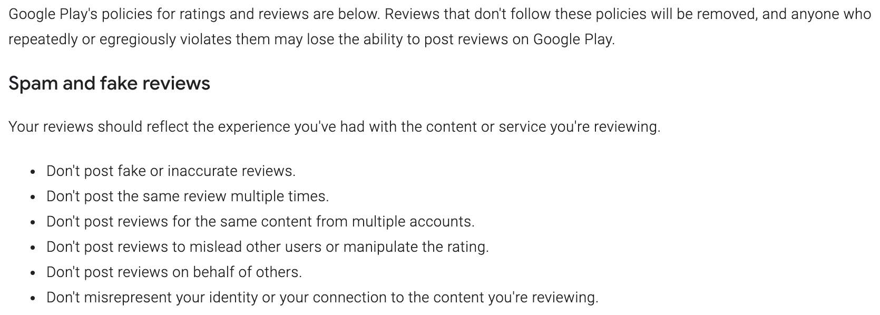
Review Policy?
Google play store policy : https://support.google.com/googleplay/android-developer/answer/7318385?hl=ko

Slide 8
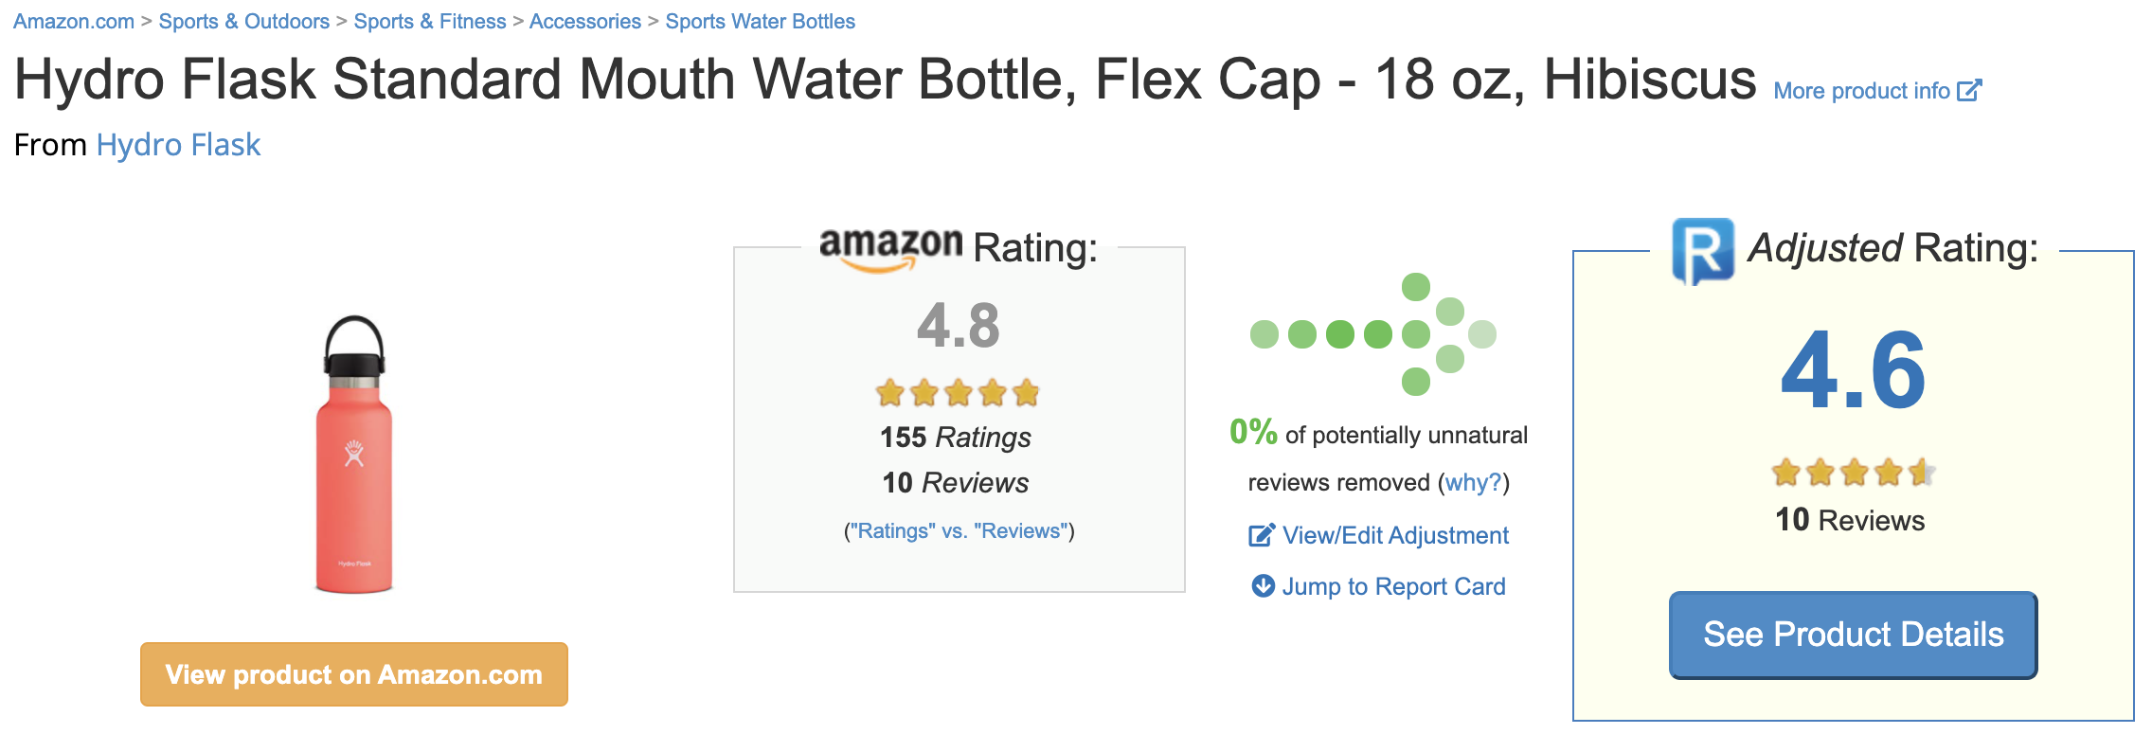
Current Solutions
Gathering Data -> Analyzing Data -> Calculating Stats
https://reviewmeta.com/
https://www.fakespot.com/

Slide 9
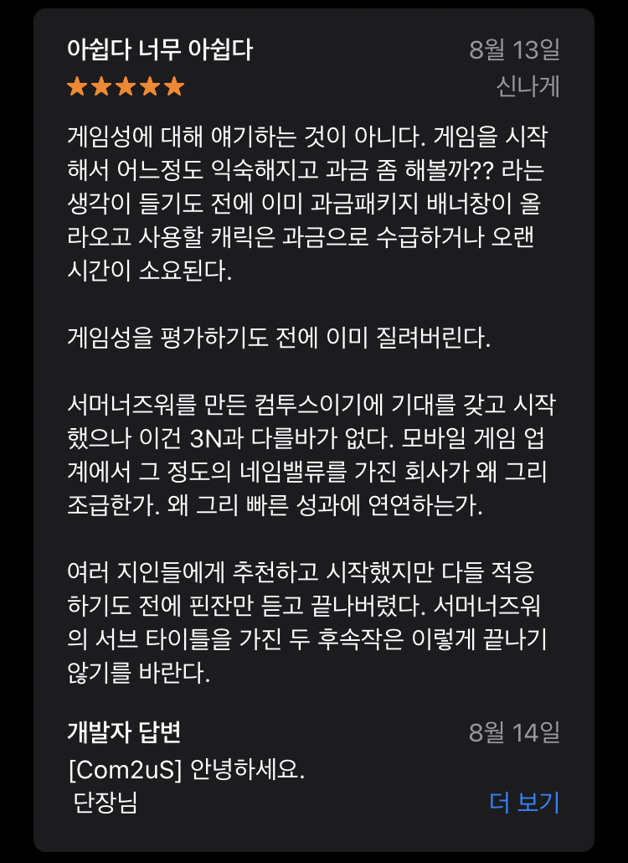
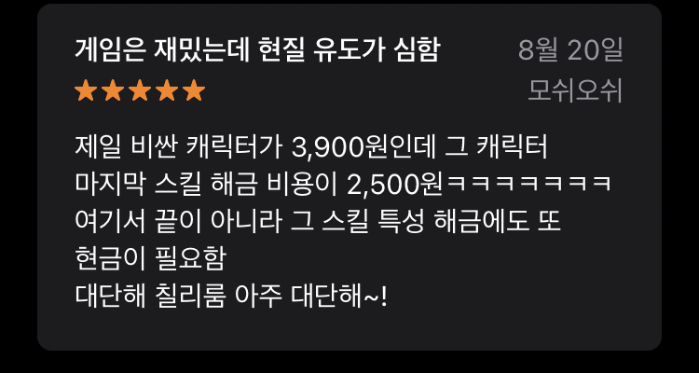
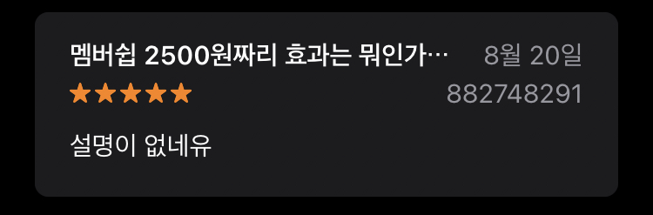
Mismatch
https://apps.apple.com/kr/app/%ED%9E%88%EC%96%B4%EB%A1%9C%EC%A6%88%EC%9B%8C-%EC%B9%B4%EC%9A%B4%ED%84%B0%EC%96%B4%ED%83%9D/id1373622259#see-all/reviews
https://www.apple.com/kr/ios/app-store/

Slide 10
Fake Review Detection
Rigged Reviews have Expression Characteristic
Fake review detection: Understanding how deception is expressed in writing(2014)
Understanding the process of writing fake online reviews(2014)
Fake Reviewer pattern
survey on fake review detection using machine learning techniques(2018)
History Pattern
Reliable fake review detection via modeling temporal and behavioral patterns(2017)

Slide 11
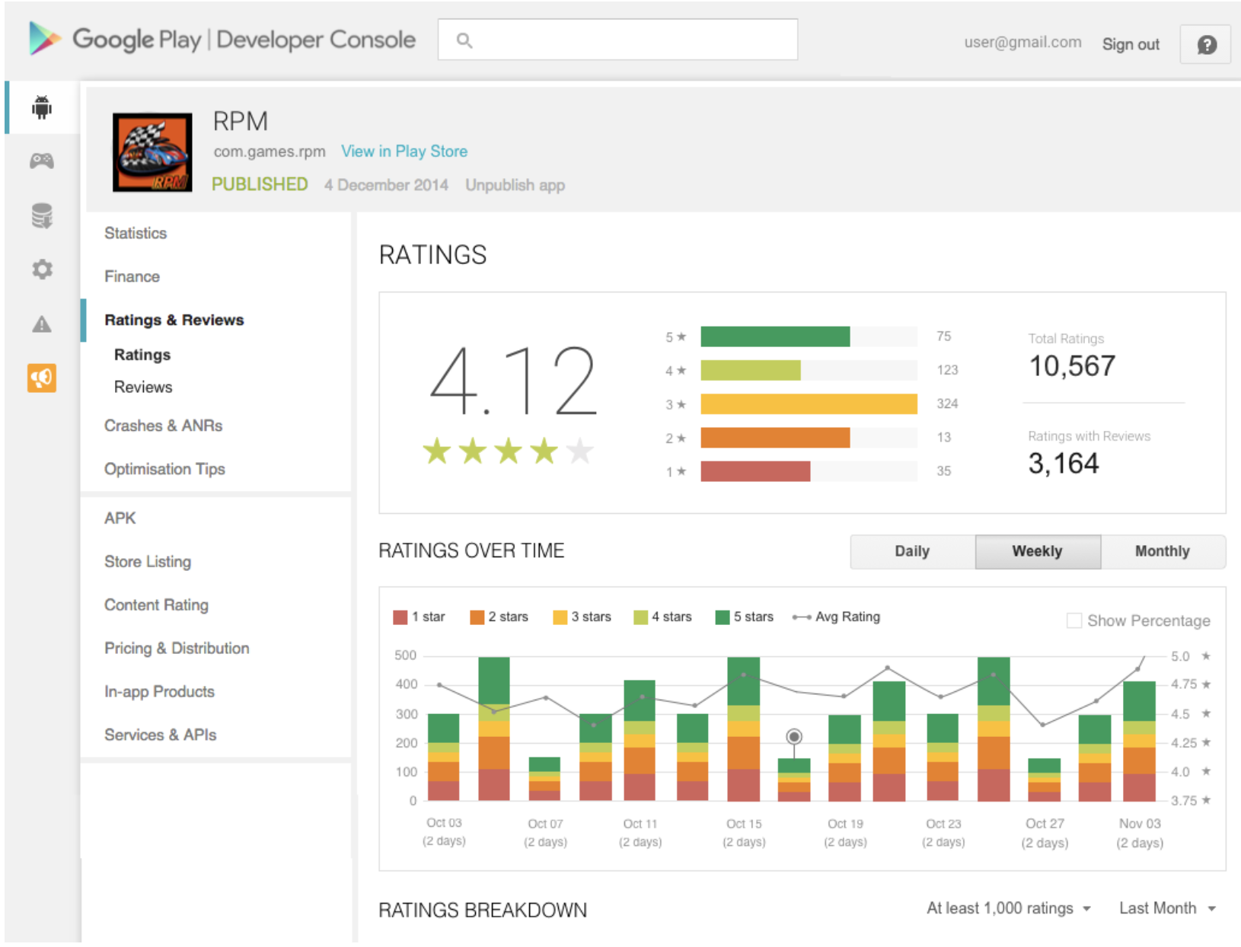
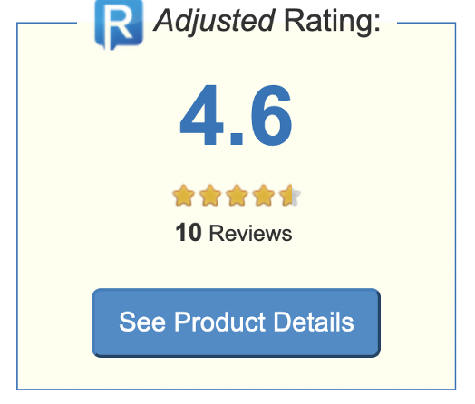
Goal
https://play.google.com/console/about/

Slide 12
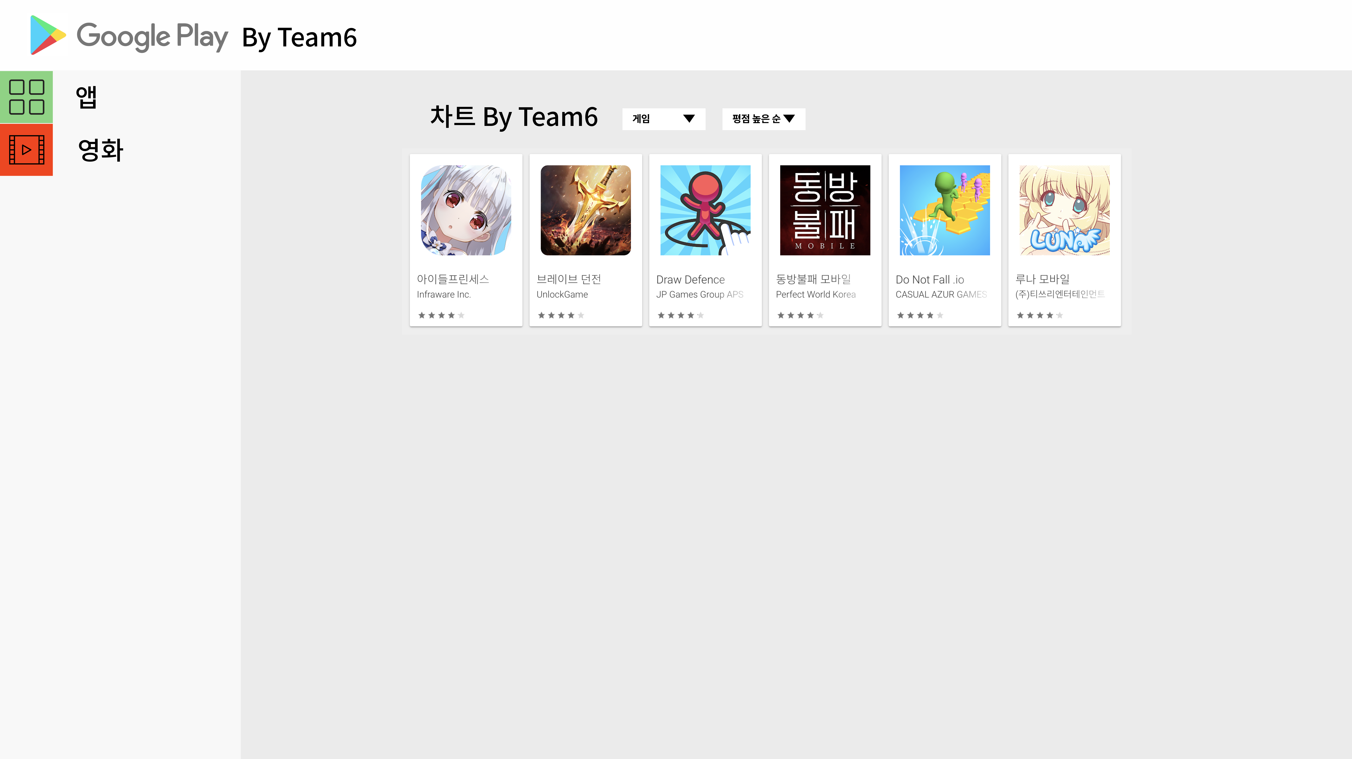
Prototype by figma

Slide 13
Prototype by figma

